Slide 1
Hotel Silverpeak Booking System
A Web-Based Hotel Reservation Platform

Slide 2
Table of Contents
Abstract / Project Overview
Introduction & Purpose
Tools & Technologies
System Features & Screenshots
Database Design & ER Diagram
Database Connection & SQL Queries
Security Measures & Validation
Challenges & Learnings
Conclusion

Slide 3
Abstract / Project Overview
Web-based reservation platform with real-time availability & bookings.
Developed with PHP, MySQL, HTML5, CSS3
Smart two-phase booking & automated pricing.
Scalable and secure design with prepared statements & input validation.

Slide 4
Introduction & Purpose
Replaces manual booking with efficient online system.
Easy room availability check, booking, and cancellation.
Automates management, reduces paperwork, improves efficiency.

Slide 5
Tools & Technologies
Frontend: HTML5, CSS3
Backend: PHP
Database: MySQL
Server: XAMPP
Security: Prepared Statements, Input Validation
Scalability: Modular design

Slide 6
Core Features
1. Availability Checking
2. Online Booking
3. Payment processing
4. cancellation
5. Customer Data

Slide 7
System Features & Screenshots
Clean header, banner, logo, and tagline
Room categories: Standard, Family, Suite
Availability check form with date pickers & dropdown
Booking & cancellation forms
Contact info, map, and social media links

Slide 8
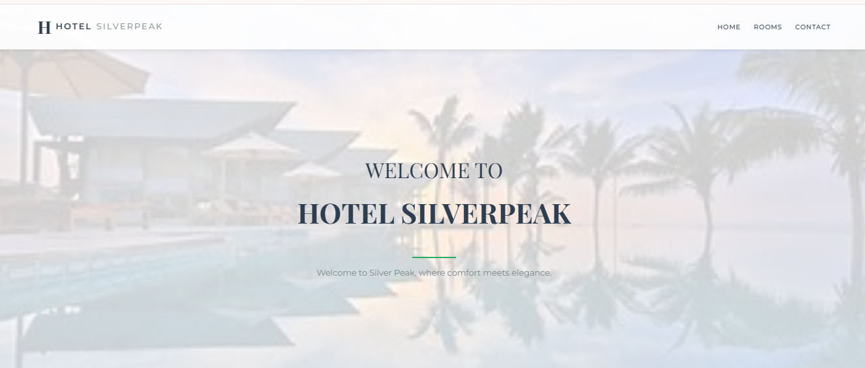

Slide 9
The image shows Hotel SilverPeak's clean, elegant website header featuring:
A bold "H HOTEL SILVERPEAK“ logo
● Simple navigation (Home | Rooms | Contact)
● A centered welcome banner with:
✧Main heading: "WELCOME TO"
✧Prominent hotel name: "HOTEL SILVERPEAK"
✧Tagline: "Where comfort meets elegance"

Slide 10
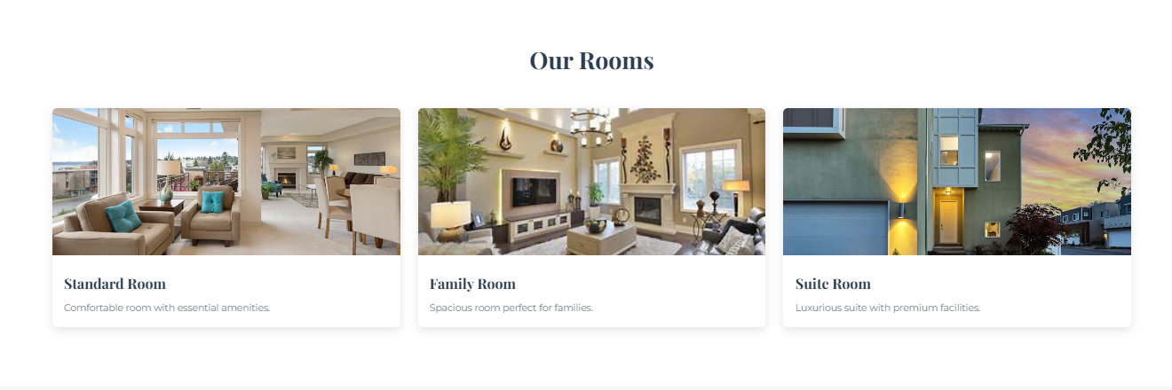

Slide 11
This image displays Hotel Silverpeak's room offerings in a clean, structured format:
1. Main Heading
○ "#Our Rooms"(clearly identifying the section)
2. Room Categories
○ Standard Room →"Comfortable room with essential amenities"
○ Family Room →"Spacious room perfect for families"
○ Suite Room →"Luxurious suite with premium facilities"

Slide 12
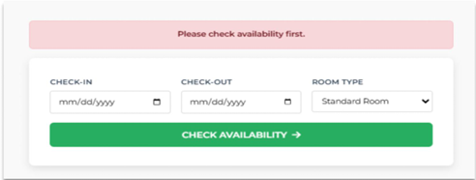

Slide 13
Availability Check Screen:
● Error message: "Please check availability first"
● Booking form with 3 fields:
✓CHECK-IN (date picker)
✓CHECK-OUT (date picker)
✓ROOM TYPE dropdown (default: Standard Room)
● "CHECK AVAILABILITY "call-to-action button (→ indicator)
● Minimalist design focusing on core booking functionality

Slide 14
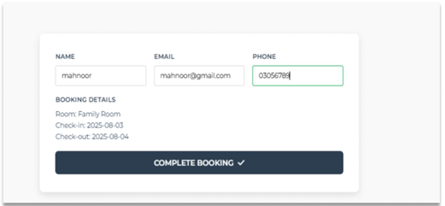

Slide 15
Displays guest details (Name: Mahnoor, Email: mahnoor@gmail.com, Phone: 03056789)
● Shows booking summary:
✓Room Type: Family Room
✓Dates: August 3-4, 2025
● Features a prominent "COMPLETE BOOKING" button (✔ indicator)

Slide 16
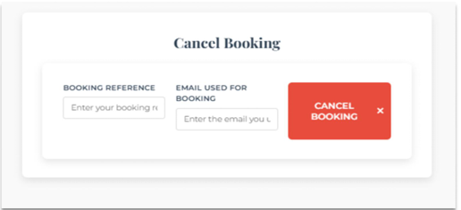

Slide 17
Cancellation Form (Empty State)
● Heading: "# Cancel Booking“
● Two input fields:
• BOOKING REFERENCE (placeholder: "Enter your booking rt")
• EMAIL USED FOR BOOKING (placeholder: "Enter the email you t")
● Red "CANCEL BOOKING“ button (warning color for destructive action)
● Minimalist form design with clear labels

Slide 18
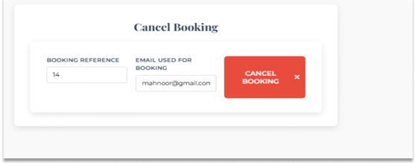


Slide 19
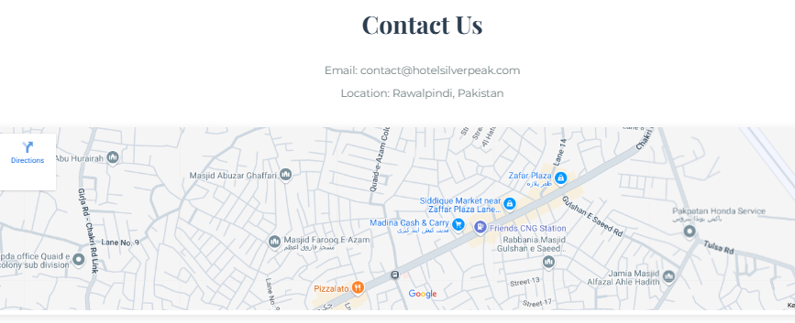
This section provides essential contact information for Hotel Silverpeak and includes an embedded map for easy navigation
● Heading: Contact Us
● Email: contact@hotelsilverpeak.com
● Location: Rawalpindi, Pakistan

Slide 20

The footer of Hotel Silverpeak features social media icons (Facebook, Instagram, Twitter, Pinterest) centered on a dark blue background.
Below them, a copyright notice states:
“© HOTELSILVERPEAK-ALLRIGHTSRESERVED.”

Slide 21
Database Connection & SQL Queries
Secure connection with PHP and MySQL
Key queries: Check room availability, Insert booking, Payment insertion,
Verify and cancel booking
Prepared statements prevent SQL injection

Slide 22
Table Details
rooms:
id: Unique room identifier
room_type: Type of room (single, double, suite)
price_per_night: Cost per night for the room
bookings:
id: Unique booking identifier
name, email, phone: Customer details
checkin, checkout: Booking dates
room_id: Foreign key linking to the room booked
payments:
id: Unique payment identifier
booking_id: Foreign key linking to booking
amount: Payment amount
payment_date: Timestamp of payment

Slide 23
Database Design & ER Diagram
Tables: rooms, bookings, payments
Relationships: Rooms (1-M) Bookings, Bookings (1-1) Payments
Key fields: id, room_type , price_per_night, booking_id, payment_date

Slide 24
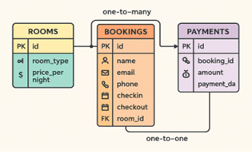

Slide 25
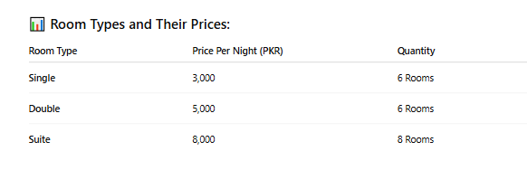
Room Categories & Pricing Structure in Database

Slide 26
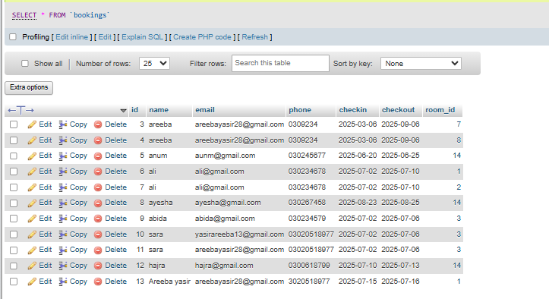
Booking Summary from Database

Slide 27
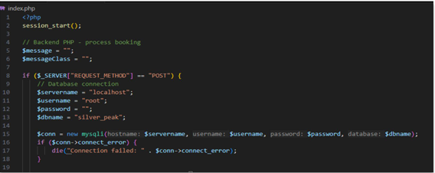
Database Connection
Code snippet for the PHP database connection

Slide 28
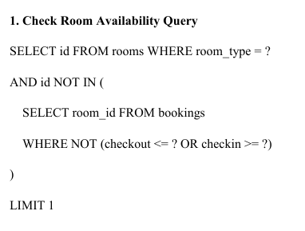
SQL QUERIES

Slide 29

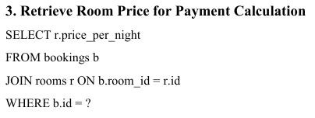

Slide 30

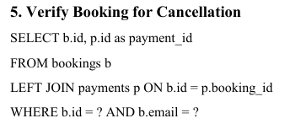

Slide 31

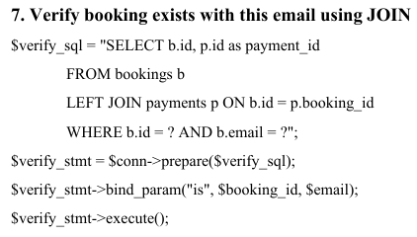


Slide 32
Security Measures & Validation
Input validation for dates, fields, email, and phone
Prepared statements with bound parameters
User-friendly error messages and validation steps

Slide 33

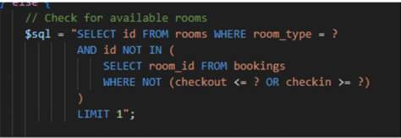
Input Validation
Use of prepared statements

Slide 34

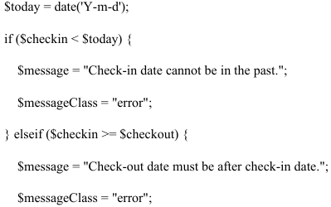
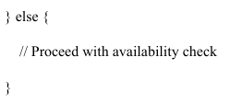
Date Validation

Slide 35
Challenges & Learnings
Challenges: DB connection, frontend-backend integration
Learnings: Query optimization, scalability, prepared statements
Future: Redis caching, CI/CD pipelines

Slide 36
Conclusion
Enhanced performance, scalability, and security
Improved database optimization and error handling
Key takeaway: Secure, scalable, and user-friendly design

